Slide 1


MS Applied Data Science Portfolio Presentation: Bryan Crigger
Notes:
Hello everyone. I'm excited to share with you the culmination of my journey through the Master of Applied Data Science program at Syracuse University. My name is Bryan Crigger and I will be presenting my portfolio, showcasing some of the projects that I have completed while in the program that not only represent my academic journey but also my growth as a data scientist. The purpose of today's presentation is to showcase these projects and demonstrate how they align with the program's learning goals.
which have prepared me to apply solutions to real-world problems.

Slide 2






Program Learning Goals
Collect, store, and access data by identifying and leveraging applicable technologies
Create actionable insight across a range of contexts (e.g. societal, business, political), using data and the full data science life cycle
Apply visualization and predictive models to help generate actionable insight
Use programming languages such as R and Python to support the generation of actionable insight
Communicate insights gained via visualization and analytics to a broad range of audiences (including project sponsors and technical team leads)
Apply ethics in the development, use and evaluation of data and predictive models (e.g., fairness, bias, transparency, privacy)
Notes:
The Master of Applied Data Science program is designed to learn both the theoretical knowledge and practical application of various techniques in the field of data science.
The program's learning goals are designed to ensure that these concepts are learned and applied throughout the program. They include:
the ability to collect, store, and access data using appropriate technologies;
create actionable insights across various contexts;
apply visualization and predictive models;
use programming languages effectively;
communicate insights to a broad range of audiences; and
apply ethics in data science.

Slide 3
Projects in Portfolio
Evaluating U.S. Opioid Prescribers
Classifying Spam vs Non-Spam Emails with NLP
Identifying most Important Factors in Calculating Home Price
Pistachio Image Classification
Notes:
The projects that I have chosen for my portfolio are the following:
From my Applied Machine Learning class: Evaluating U.S. Opioid Prescribers
Natural Language Processing: Classifying Spam vs Non-Spam Emails with NLP
Big Data Analytics: Identifying most Important Factors in Calculating Home Price
Deep Learning in Practice: Pistachio Image Classification
Each of these project have helped me further hone my Data Science skills and have allowed me to become a more well-rounded Data Scientist.

Slide 4
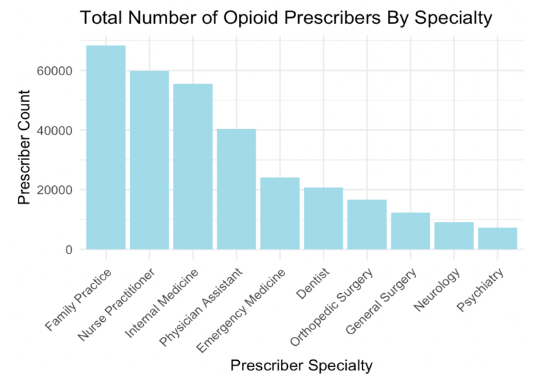
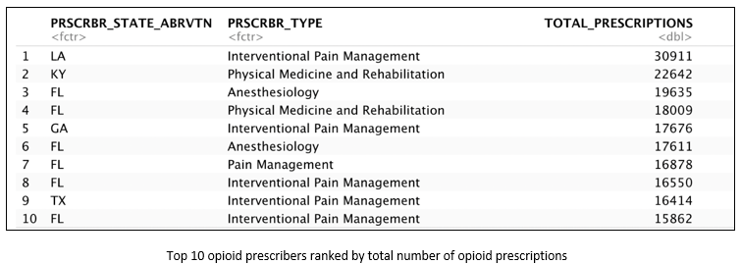
Applied Machine Learning
Project focus: Analysis of opioid prescription patterns in the U.S.
Key findings: Identification of high-risk areas and prescriber types
Techniques: Association Rule Mining, KMeans Clustering, and Naive Bayes
Learning outcomes: Southern states including Florida and Texas have the highest volume of opioid prescriptions.
Notes:
For the 1st project in my portfolio, I'll start with the project on opioid prescription patterns in the United States. The objective was to analyze data from the Centers for Medicare & Medicaid Services to uncover prescribing trends and identify high-risk areas and prescriber types. The analysis, which included over 23 million records, revealed a highly skewed distribution of opioid prescriptions, with a small percentage of prescribers responsible for a large volume of prescriptions. This project allowed me to apply data mining techniques, like Association Rule Mining, Clustering, and Classification Algorithms, showcasing the ability to handle large datasets and generate actionable insights. The learning objective of applying ethics in data science techniques was used largely here by highlighting the need for careful monitoring and increased access to rehabilitation services.

Slide 5
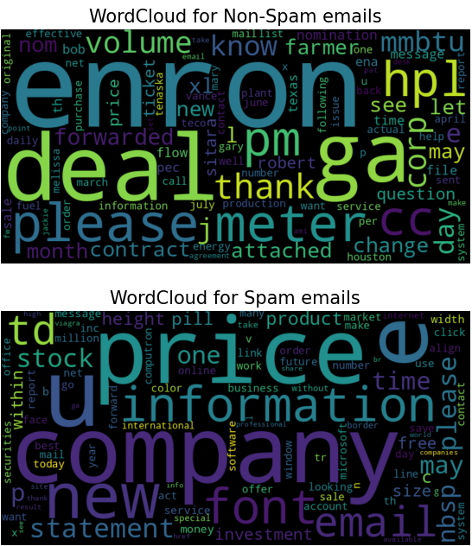
Natural Language Processing
Project focus: Email classification using the Enron email corpus
Key findings: CNN model was more accurate than Naïve Bayes models, with a test accuracy of 94.87%
Techniques: Naïve Bayes classifiers (Gaussian, MNB, Bernoulli), and CNN models
Learning outcomes:
Importance of how data is vectorized/cleaned
Test multiple modeling methods and preprocessing techniques
Notes:
For my 2nd project in my portfolio
I highlight my Natural Language Processing project, which tackled the challenge of classifying emails from the Enron corpus as either spam or non-spam. For this project several methods for cleaning and processing the data were tested, as well as tested multiple techniques including Naïve Bayes and CNN models. Testing various cleaning and modeling methods highlighted the importance of testing various techniques opposed to using the same method and approach for all similar problems. While the Multinomial Naive Bayes classifier performed well, with an accuracy of 88%, the best model was a CNN model with 94.87%. This project exemplified the creation of actionable insights and the critical role of effective communication in data science, particularly in how we can enhance email filtering systems.

Slide 6
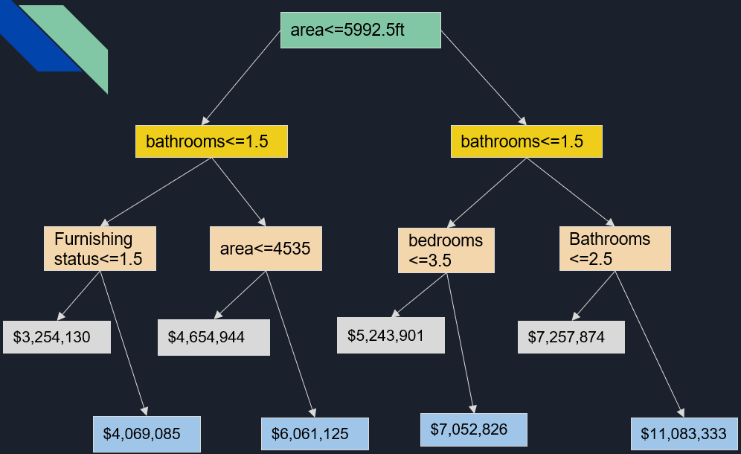
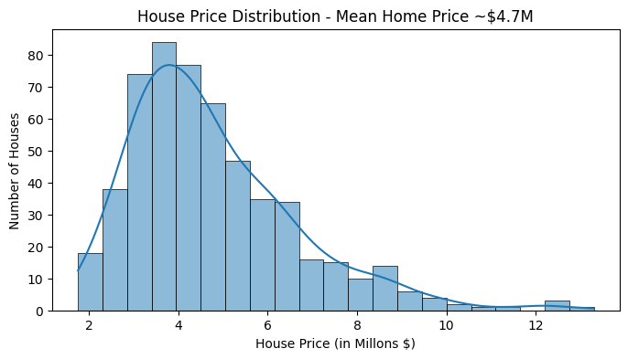
Big Data Analytics
Project focus: Housing market analysis for Zillow
Key findings: Home sqft is the most significant factor in determining house price for homes <$2M.
Techniques: Regression, Decision Trees, Neural Networks
Learning outcomes:
Difficult to reduce multicollinearity between variables
Top factors that predict home value are not consistent across all price ranges.
Notes:
For my 3rd project in my portfolio
In our Big Data Analytics project, we analyzed housing data to identify factors influencing home prices, with a focus on Zillow's dataset from Kaggle. The analysis utilized regression models, decision trees, and neural networks, finding that square footage significantly impacts home value, particularly for homes over $2M. The project's outcome, which was to be a recommendation for Zillow to adopt a neural network model, highlights the learning objective of creating actionable insights for the business. An additional learning outcome from this project was how to work with and build a model for data that is highly correlated

Slide 7
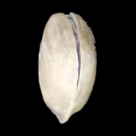
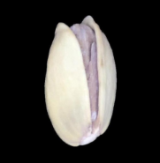
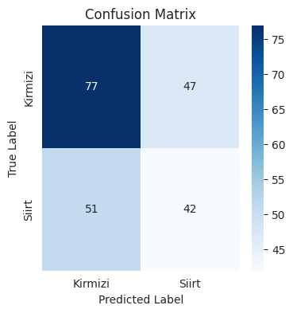
Deep Learning in Practice
Kirmizi Pistachio
Siirt Pistachio
Project focus: Image classification of pistachio species
Key findings: VGG16 model with transfer learning performed best
Techniques: CNN models and transfer learning
Learning outcomes:
Model accuracy is not the only important metric
Important to check precision and recall to confirm no model bias
Notes:
My 4th and final project in my portfolio was from the Deep Learning in Practice course, in which the project involved using Convolutional Neural Networks to classify images of pistachios into two species, with a dataset provided from Kaggle. The real-world application for a project like this would be to separate pistachios by species type or food quality. Two base models were tested with transfer learning, with the EfficientNetB0 model having the highest accuracy. However, after checking precision and recall, we noticed that the model learned to instead only guess one pistachio type, and as a consequence highly biased. Therefore, the VGG16 base model was chosen since it had more true positives for both pistachio species, despite having an overall lower accuracy.
This project showcased my skills in data preparation, model tuning, and ethical data handling, including the importance of balancing and standardizing the data to avoid biases.

Slide 8
Reflection over Learning Goals
Store
Collect, store, and access data by identifying and leveraging applicable technologies
Apply
Apply visualization and predictive models to help generate actionable insight
Communicate
Communicate insights gained via visualization and analytics to a broad range of audiences (including project sponsors and technical team leads)
Create
Create actionable insight across a range of contexts (e.g. societal, business, political), using data and the full data science life cycle
Use
Use programming languages such as R and Python to support the generation of actionable insight
Apply
Apply ethics in the development, use and evaluation of data and predictive models (e.g., fairness, bias, transparency, privacy)
Notes:
Through these projects I have presented in my portfolio, I believe I have achieved each of these core learning goals. Each of these projects addressed a unique challenge, allowing me to apply the full spectrum of data science methodologies to a variety of data science problems. This portfolio not only represents my journey in the Applied Data Science program but also my readiness to tackle new challenges in the field. These experiences have equipped me with a broad range of skills and techniques to approach data-driven decision-making and innovation in my future career.
These projects collectively demonstrate not only my technical skills but also my ability to apply data science principles to solve complex problems across different domains. Through this journey, I've developed a robust understanding of how to leverage data science techniques to create actionable insights, communicate effectively, and effectively handle the ethical issues when dealing with data.

Slide 9
THANK YOU
Email: bcrigger@syr.edu
GitHub: github.com/bryancrigger/
LinkedIn: linkedin.com/in/bryancrigger/
Notes:
Now, I’d like to thank you for your attention and for the opportunity to share my work with you. I hope this presentation has given you a glimpse into my growth as a data scientist and the potential I bring to the field. I appreciate the opportunity to be part of the M.S. in Applied Data Science program. I intend to continue to learn more in the field of data science as I apply these skills in my career and potentially even continue on to pursue my PhD. Feel free to reach out to me through email or LinkedIn with any questions or find out what I’m currently working on through my GitHub.

